Slide 1





RxLink
Point of prescribing ePA and eRx solution suite for providers

Slide 2


UnitedHealthcare Member Bio
Judy Pullman had her annual physical one week ago and was told her cholesterol level may be concerning. A full lipid panel was ordered for her and now she is returning for a follow-up appointment to discuss the lab results with her doctor.
After reviewing the lab results with Judy, the doctor confirms she does have high cholesterol and would to prescribe Livalo to manage her condition.

Slide 3



RxLink
Point of prescribing ePA and eRx solution suite for providers
PHASE 1
PHASE 1
PHASE 2
RxLink Lite
RxLink Full
EMR RxLink
Proprietary and Confidential. Do not distribute.
Dr. Hamma
Dr. Jones
Dr. Marshall
A partially integrated EMR system using RxLink application services and design.
A stand-alone Link application for doctors who do not have an EMR system or use Link for medical.
A fully integrated EMR system using RxLink API services.
Patient specific eligibility and formulary data
Real-time trial claim results
Lower cost alternatives
Patient/drug specific ePA questions, no fax or phone
Secure messaging/data transfer
Digital intake and form submission, no fax or phone
Instant approval, if appropriate
Electronic prescription submission
Patient specific eligibility and formulary data
Real-time trial claim results
Lower cost alternatives
Patient/drug specific ePA questions, no fax or phone
Secure messaging/data transfer
Digital intake and form submission, no fax or phone
Instant approval, if appropriate
Patient specific eligibility and formulary data
Automatic prior authorization alert
Lower cost alternatives
Patient/drug specific ePA questions, no fax or phone
Secure messaging/data transfer
Digital intake and form submission, no fax or phone
Instant approval, if appropriate
Electronic prescription submission

Slide 4
RxLink Lite

Slide 5

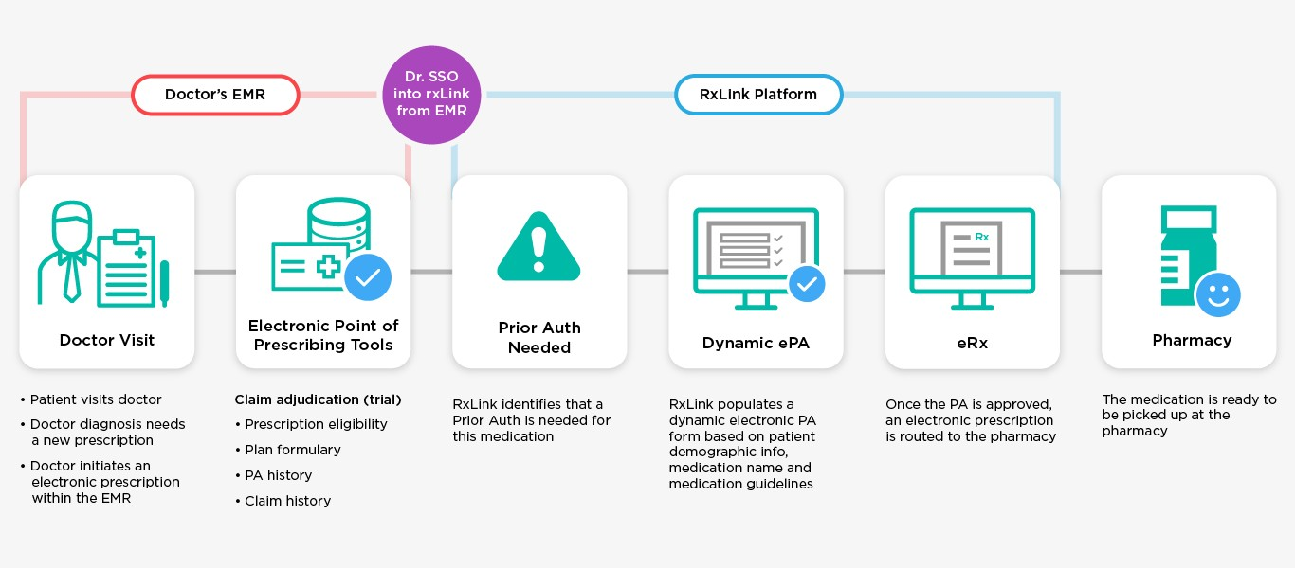
RxLink Lite
Dr. Hamma

Slide 6
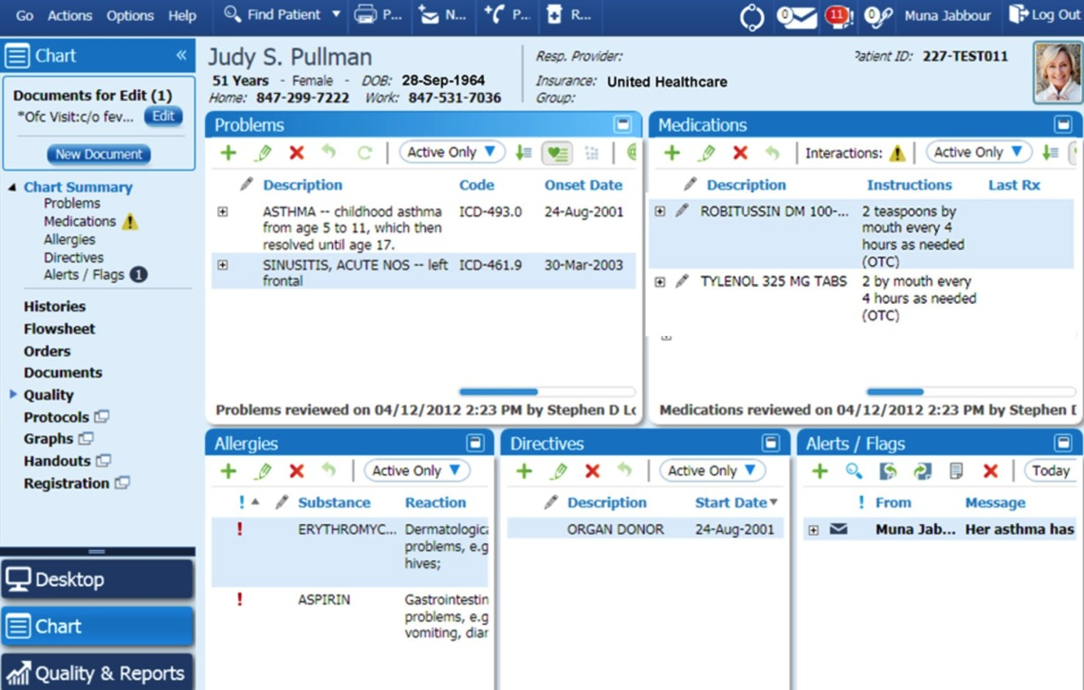
RxLink Lite
Dr. Hamma
Patient Chart (9:05 am)
Add Medication
Trial Claim Result
ePA Form
PA Decision
eRx Submitted (9:20 am)
Patient Chart
The doctor can add a medication directly from Judy’s electronic health record.

Slide 7
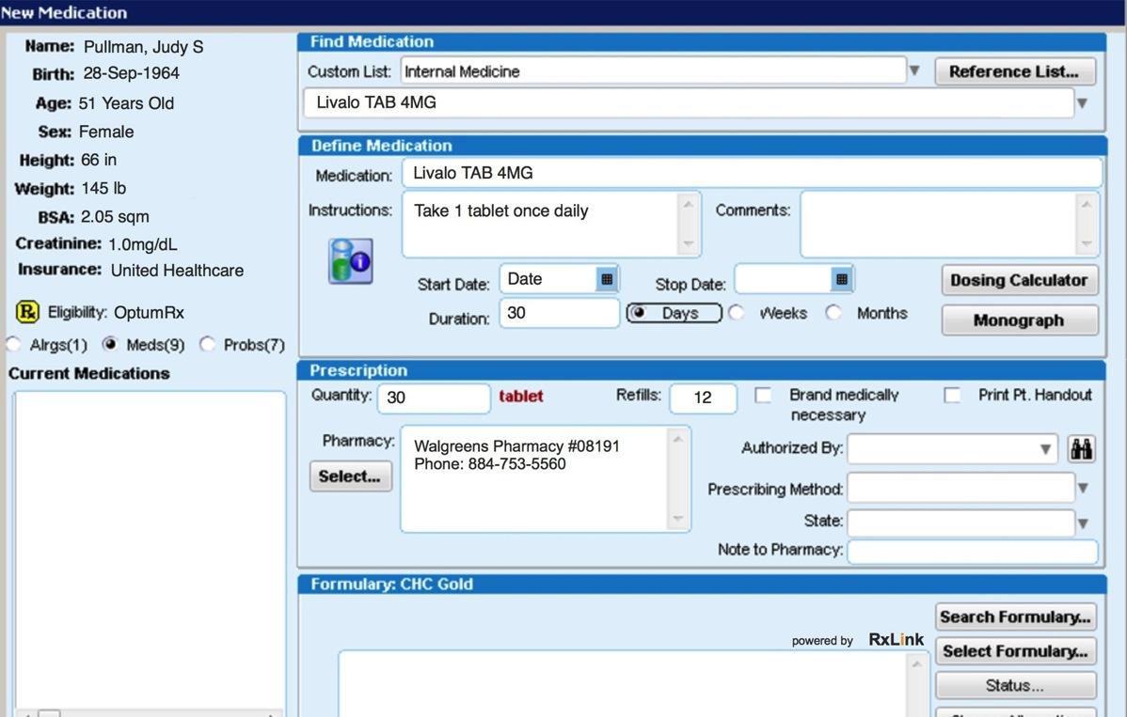
RxLink Lite
Dr. Hamma
Patient Chart (9:05 am)
Add Medication
Trial Claim Result
ePA Form
PA Decision
eRx Submitted (9:20 am)
Add Medication
In the EMR the doctor submits a prescription for Livalo as usual.
In the background, before the e-prescription is sent to the
pharmacy, the system compares Livalo against a list of drugs that commonly require a prior authorization.
If the drug is not on the list, the e-prescription is routed to the pharmacy.
If the drug is on the list a trial claim is initiated.
If the trial claim result is that a prior authorization is needed, an alert is presented. Otherwise, the e-prescription is routed to the pharmacy.

Slide 8
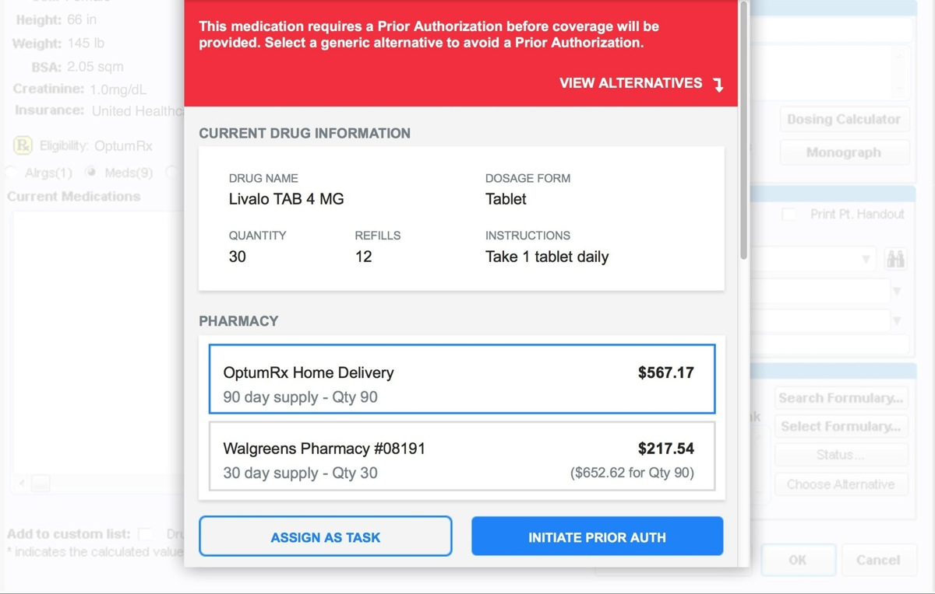
RxLink Lite
Dr. Hamma
Patient Chart (9:05 am)
Add Medication
Trial Claim Result
ePA Form
PA Decision
eRx Submitted (9:20 am)
Trial Claim Result
For Livalo, RxLink flags Livalo as a drug that may need a prior
authorization and integrates with the patient’s health record, plan, eligibility and formulary data to run the Trial Claim process.
The doctor is presented with a rxLink Lite window.
The doctor is informed via RxLink that a PA is needed and, if appropriate, alternative drugs and LCAs that are therapeutic equivalents to Livalo that do not require a prior authorization are presented.
The doctor and Judy determine Livalo is the best course of treatment, so the doctor initiates the prior authorization.

Slide 9
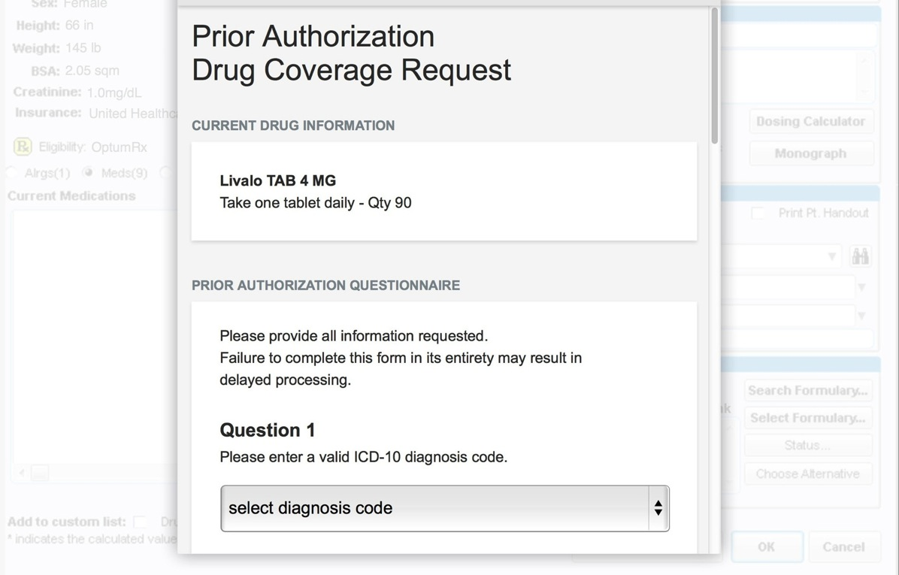
RxLink Lite
Dr. Hamma
Patient Chart (9:05 am)
Add Medication
Trial Claim Result
ePA Form
PA Decision
eRx Submitted (9:20 am)
Patient/Drug Specific ePA Request Form
When a PA request is initiated, the prescription is placed in a pending queue until the PA approval decision is made.
If a PA is needed, a patient- specific ePA form is presented, thus allowing the doctor to enter the required info immediately. If extra information is required, the secure messaging feature within RxLink can be used to attach the lab results to the PA form.
As much as possible, the patient information is gathered from the EMR and pre-populated into RxLink.

Slide 10
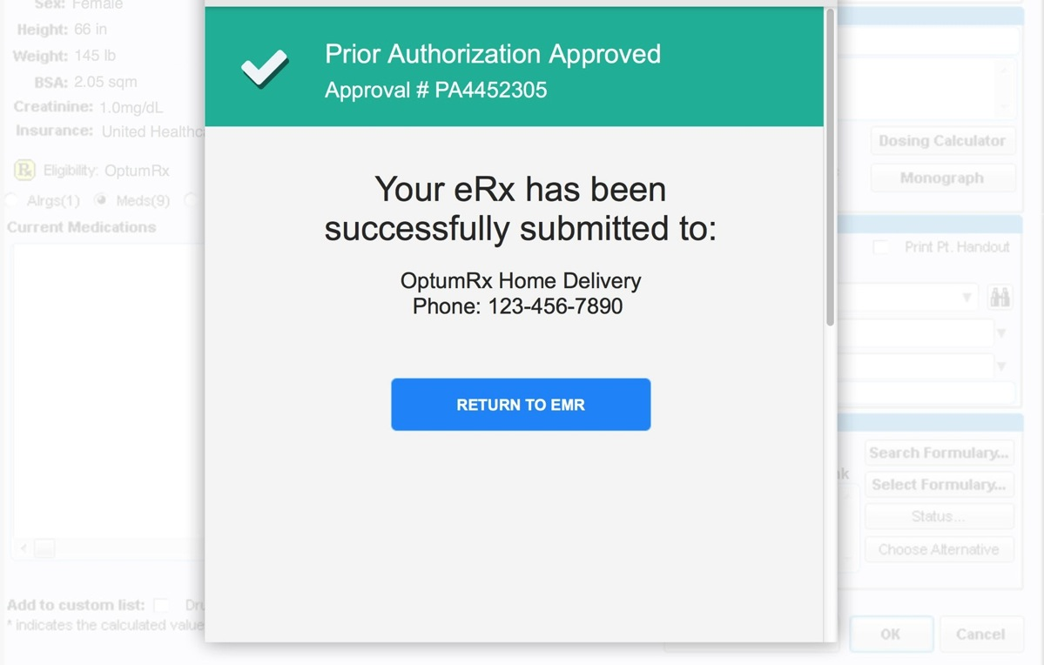
RxLink Lite
Dr. Hamma
Patient Chart (9:05 am)
Add Medication
Trial Claim Result
ePA Form
PA Decision
eRx Submitted (9:20 am)
Prior Auth Decision
If appropriate, an immediate ePA approval can be given and the eRx is released from the
pending queue and routed to the pharmacy.
If the PA request cannot be approved immediately it will go into a review process. The doctor and patient will be notified once the decision is made.

Slide 11
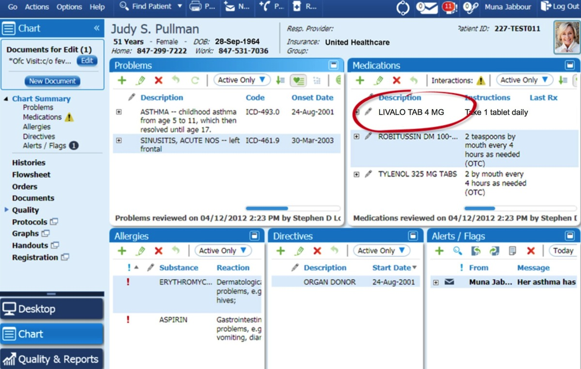
RxLink Lite
Dr. Hamma
Patient Chart (9:05 am)
Add Medication
Trial Claim Result
ePA Form
PA Decision
eRx Submitted (9:20 am)
Prescription Submitted
Once the prior authorization request is approved and eRx is submitted, the EMR is updated to reflect the new prescription.
Judy is able to go directly to the pharmacy after her doctor’s appointment, pick up her prescription for Livalo, and start her treatment plan.
If Judy uses mail order she can leave the doctor’s office knowing her prescription will arrive at her doorstep in a few days.

Slide 12
RxLink Full

Slide 13

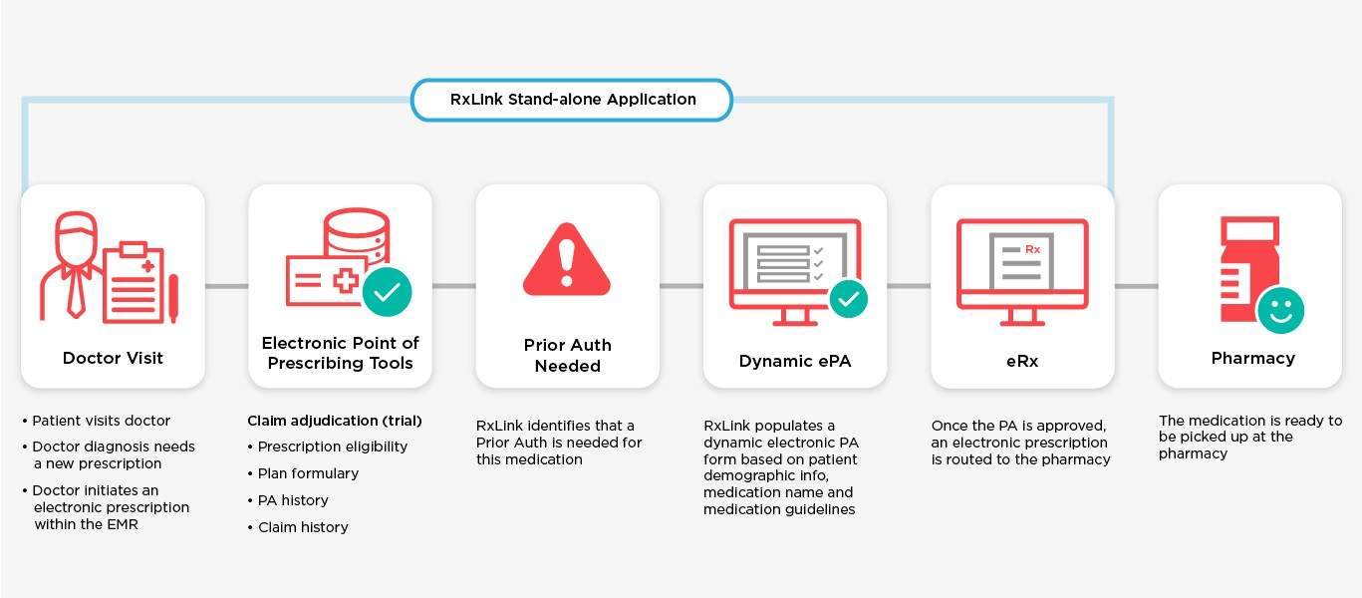
RxLink Full
Dr. Jones

Slide 14
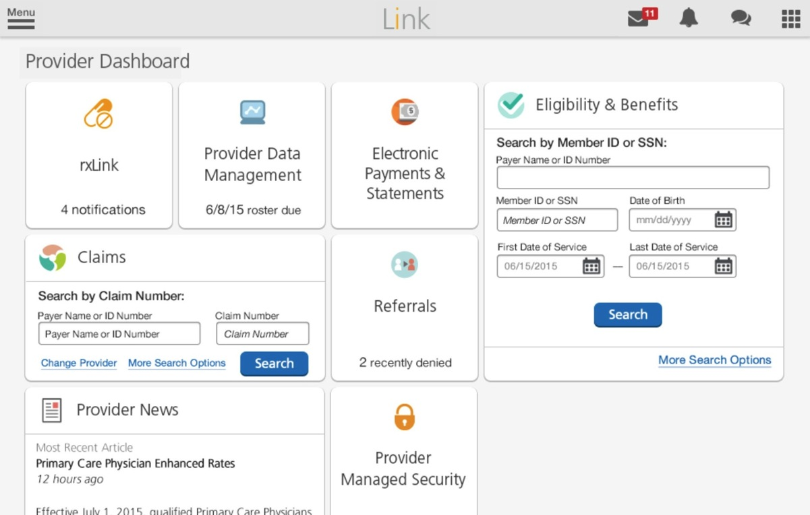
RxLink Full
Dr. Jones
Provider Dashboard
eligibilityLink
RxLink Patient Chart
Add Medication
Trial Claim Result
ePA Form
PA Decision
eRx Submitted
Provider Dashboard
From the Provider dashboard, the doctor proceeds to view Judy’s eligibility and claim information.

Slide 15
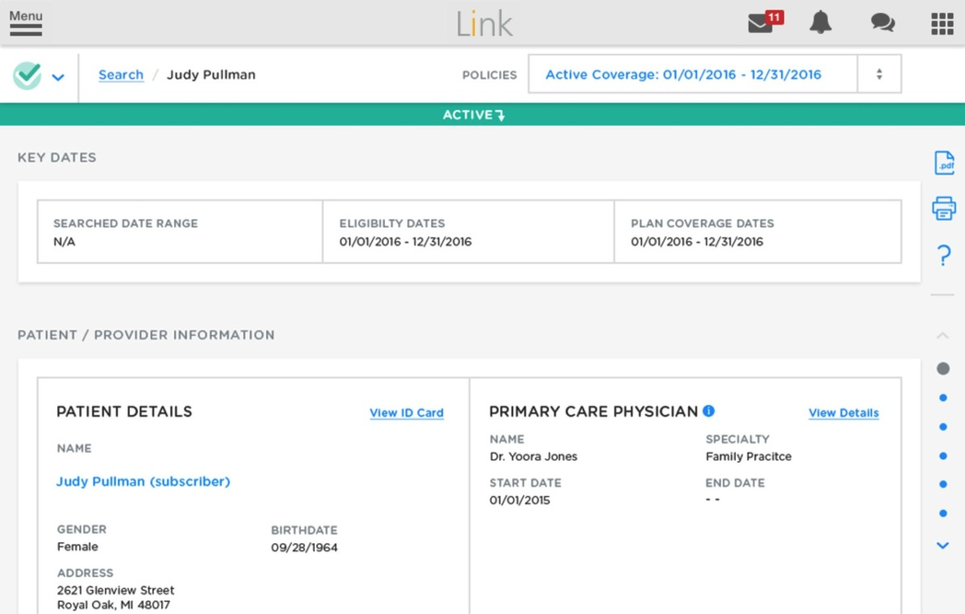
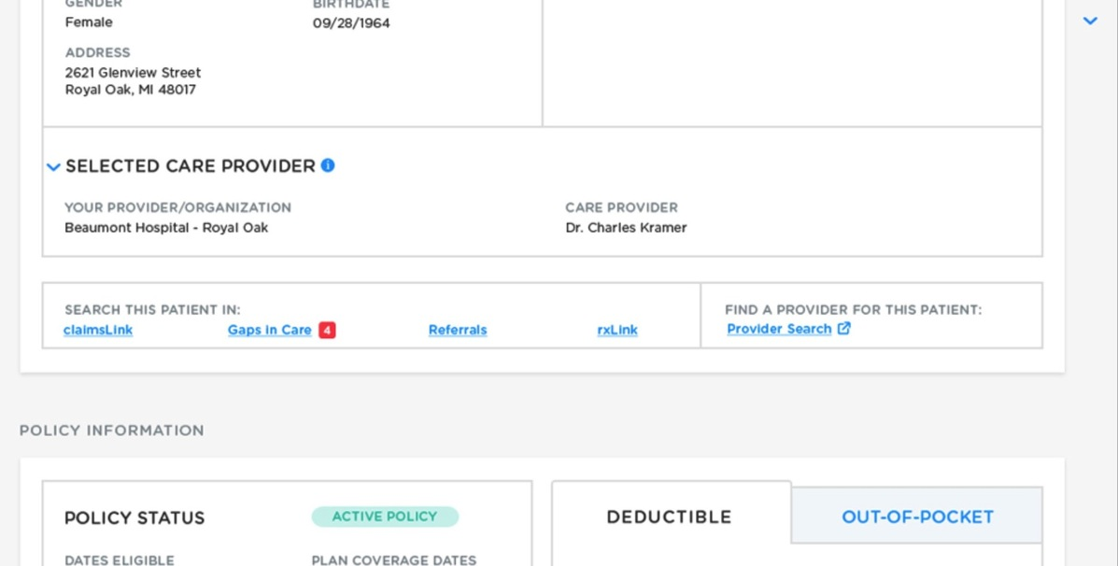
RxLink Full
Dr. Jones
Provider Dashboard
eligibilityLink
RxLink Patient Chart
Add Medication
Trial Claim Result
ePA Form
PA Decision
eRx Submitted
eligibilityLink
After searching for Judy Pullman from the eligibility tile, the doctor clicks the RxLink link to view current medications, Rx claim history, or to prescribe a new medication.

Slide 16
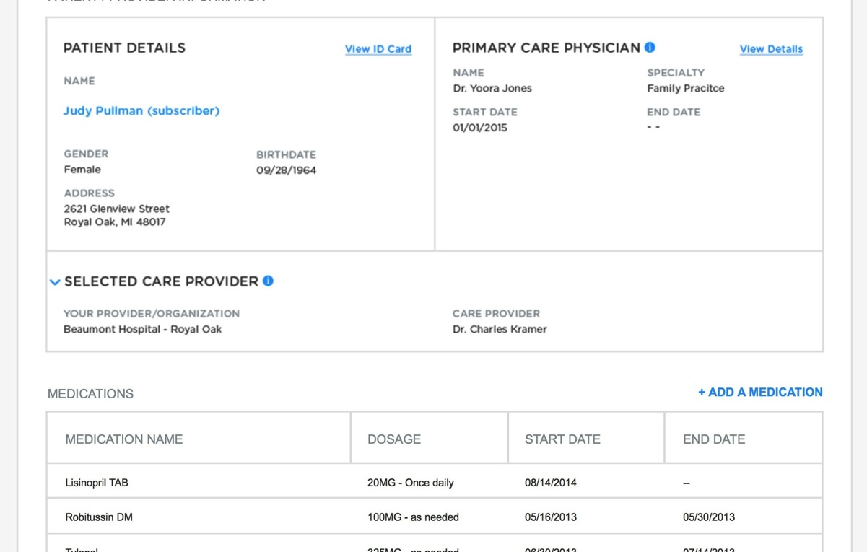
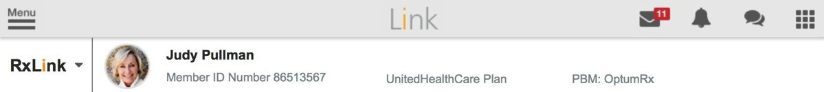
RxLink Full
Dr. Jones
Provider Dashboard
eligibilityLink
RxLink Patient Chart
Add Medication
Trial Claim Result
ePA Form
PA Decision
eRx Submitted
RxLink Patient Chart
Quick-connecting from eligibilityLink to RxLink brings the doctor directly to Judy’s prescription chart where Judy’s
basic medical information, current medications, Rx claim history and prior authorization history can be viewed.
The doctor can also add a new prescription for Judy’s recent cholesterol diagnosis.

Slide 17
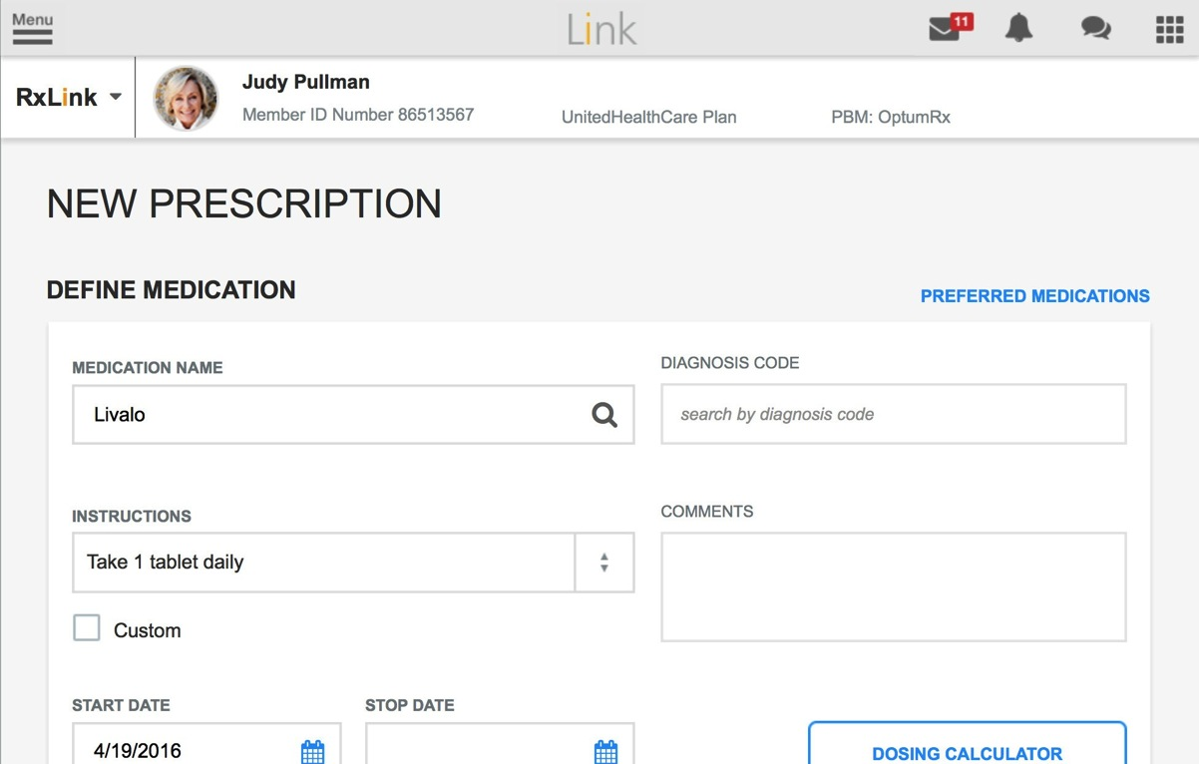
RxLink Full
Dr. Jones
Provider Dashboard
eligibilityLink
RxLink Patient Chart
Add Medication
Trial Claim Result
ePA Form
PA Decision
eRx Submitted
Add a Medication
In the RxLink application, the doctor submits a prescription for Livalo and RxLink compares Livalo against a list of drugs that commonly require a prior authorization.
If the drug is not on the list, the e-prescription is routed to the pharmacy.
If the drug is on the list a trial claim is initiated.
If the trial claim result is that a prior authorization is needed, an alert is presented. Otherwise, the e-prescription is routed to the pharmacy.

Slide 18
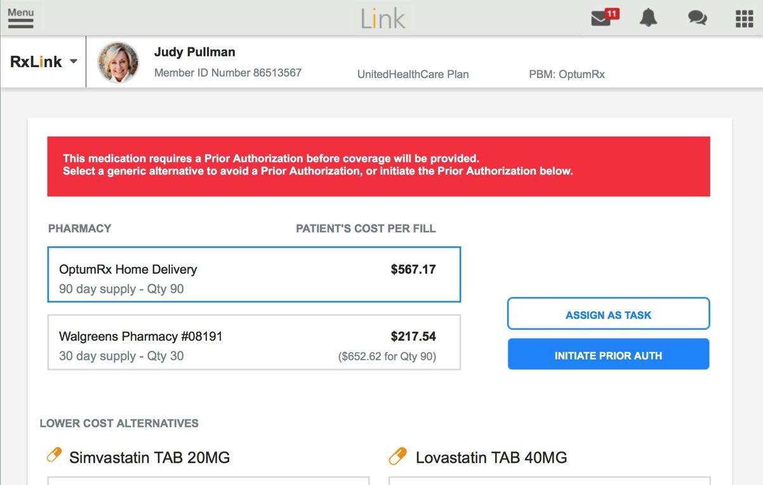
RxLink Full
Dr. Jones
Provider Dashboard
eligibilityLink
RxLink Patient Chart
Add Medication
Trial Claim Result
ePA Form
PA Decision
eRx Submitted
Trial Claim Result
For Livalo, RxLink flags Livalo as a drug that may need a prior
authorization and integrates with the patients health record, plan, eligibility and formulary data to run the Trial Claim process.
The doctor is presented with a RxLink Lite window.
The doctor is informed via RxLink that a PA is needed and, if appropriate, alternative drugs and LCAs that are therapeutic equivalents to Livalo that do not require a prior authorization are presented.
The doctor and Judy determine Livalo is the best course of treatment, so the doctor initiates the prior authorization.

Slide 19
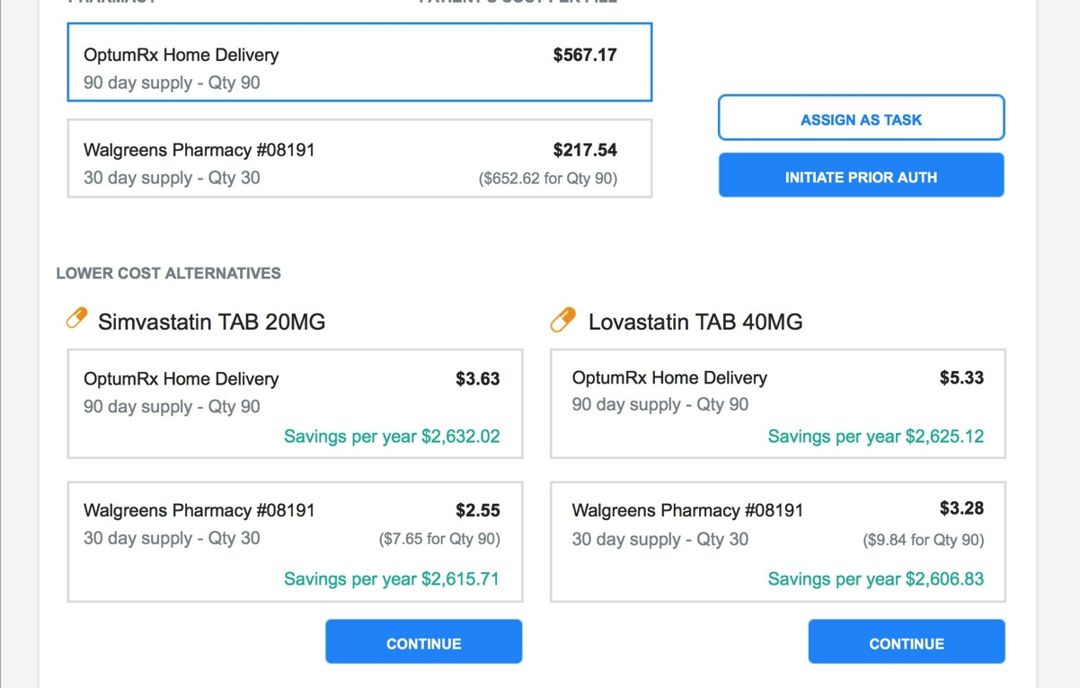
RxLink Full
Dr. Jones
Provider Dashboard
eligibilityLink
RxLink Patient Chart
Add Medication
Trial Claim Result
ePA Form
PA Decision
eRx Submitted
Trial Claim Result
For Livalo, RxLink flags Livalo as a drug that may need a prior
authorization and integrates with the patients health record, plan, eligibility and formulary data to run the Trial Claim process.
The doctor is presented with a RxLink Lite window.
The doctor is informed via RxLink that a PA is needed and, if appropriate, alternative drugs and LCAs that are therapeutic equivalents to Livalo that do not require a prior authorization are presented.
The doctor and Judy determine Livalo is the best course of treatment, so the doctor initiates the prior authorization.

Slide 20
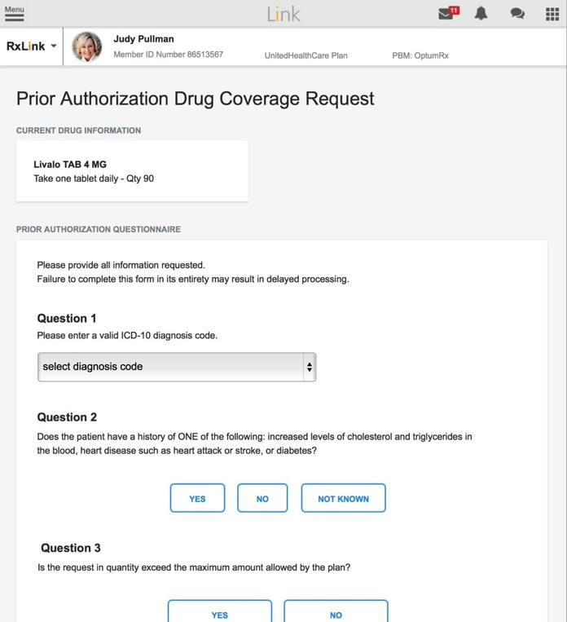
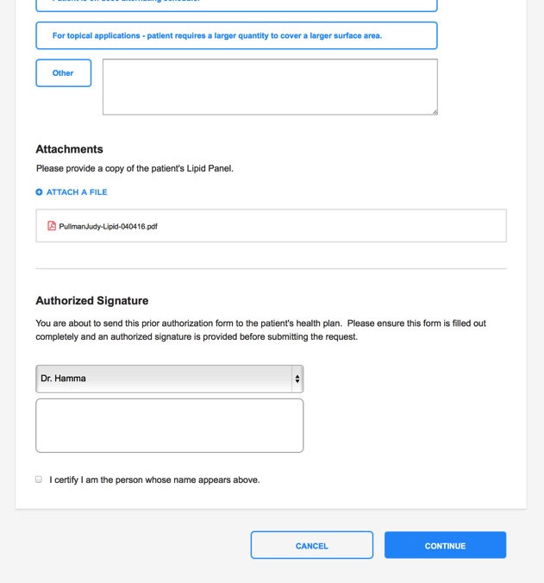
RxLink Full
Dr. Jones
Provider Dashboard
eligibilityLink
RxLink Patient Chart
Add Medication
Trial Claim Result
ePA Form
PA Decision
eRx Submitted
Patient/Drug Specific ePA Request Form
When a PA request is initiated, the prescription is placed in a pending queue until the PA approval decision is made.
If a PA is needed, a patient- specific ePA form is presented, thus allowing the doctor to enter the required info immediately. If extra information is required, the secure messaging feature within RxLink can be used to attach the lab results to the PA form.
As much as possible, the patient information is gathered from the EMR and pre-populated into RxLink.

Slide 21
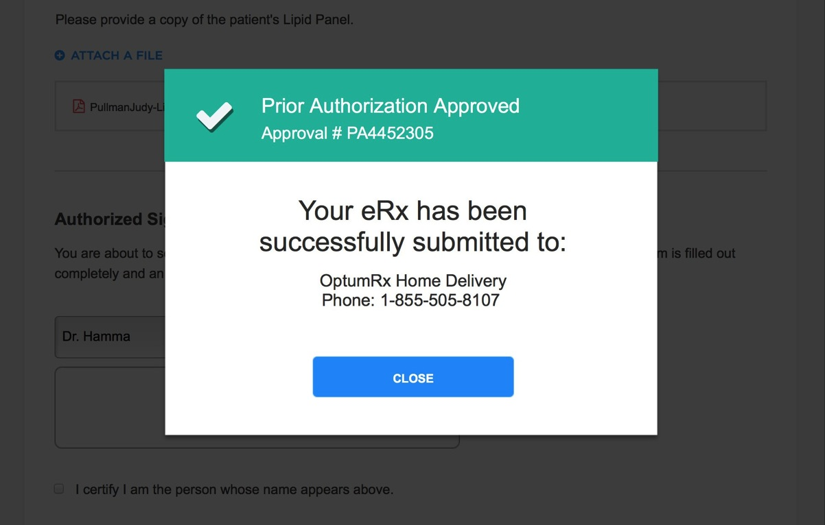
RxLink Full
Dr. Jones
Provider Dashboard
eligibilityLink
RxLink Patient Chart
Add Medication
Trial Claim Result
ePA Form
PA Decision
eRx Submitted
Prior Authorization is Approved
Once the dynamic ePA form is submitted, an immediate approval can be given, if appropriate. In Judy’s case, the prior authorization request was quite straight-forward and has been approved. Now the
e-prescription is released from the pending queue and routed to the pharmacy.
In other cases, the PA request will go into a review process, and doctor and patient will be notified once the decision is made.

Slide 22
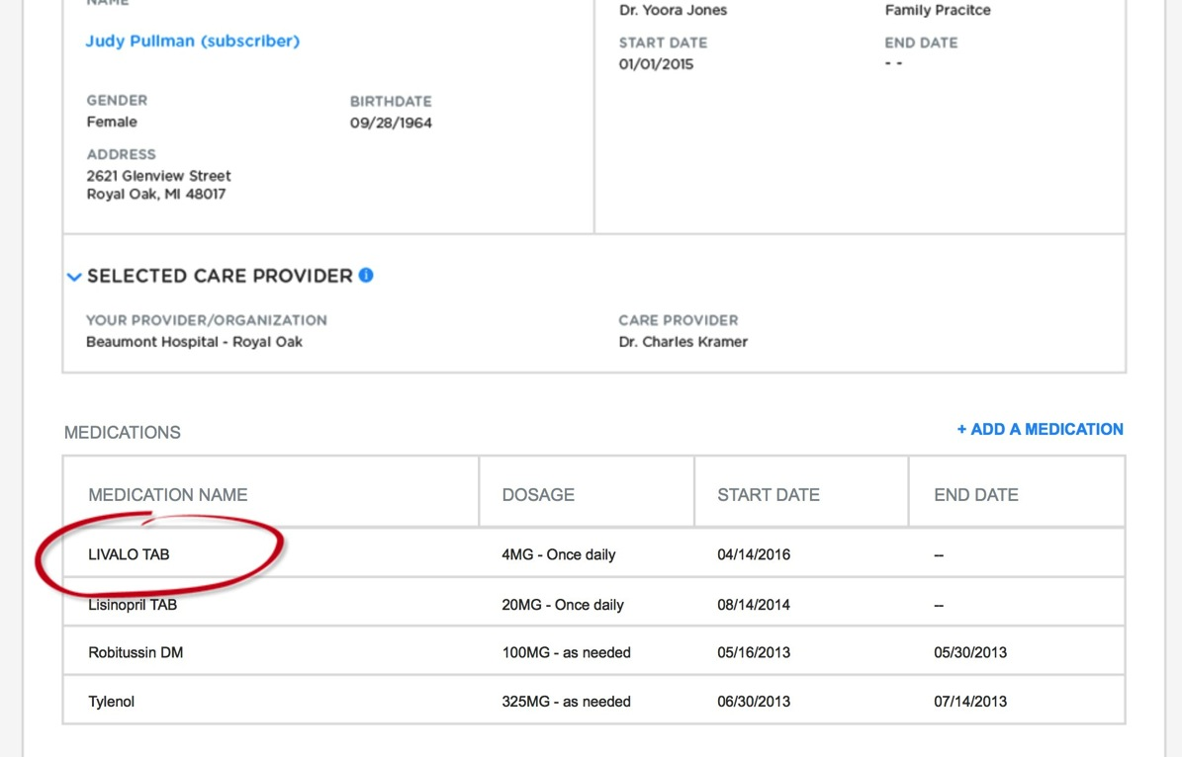
RxLink Full
Dr. Jones
Provider Dashboard
eligibilityLink
RxLink Patient Chart
Add Medication
Trial Claim Result
ePA Form
PA Decision
eRx Submitted
Prescription Submitted
Once the prior authorization request is approved and eRx is submitted, the EMR is updated to reflect the new prescription.
Judy is able to go directly to the pharmacy after her doctor’s appointment, pick up her prescription for Livalo, and start her treatment plan.
If Judy uses mail order she can leave the doctor’s office knowing her prescription will arrive at her doorstep in a few days.

Slide 23

EMR RxLink

Slide 24

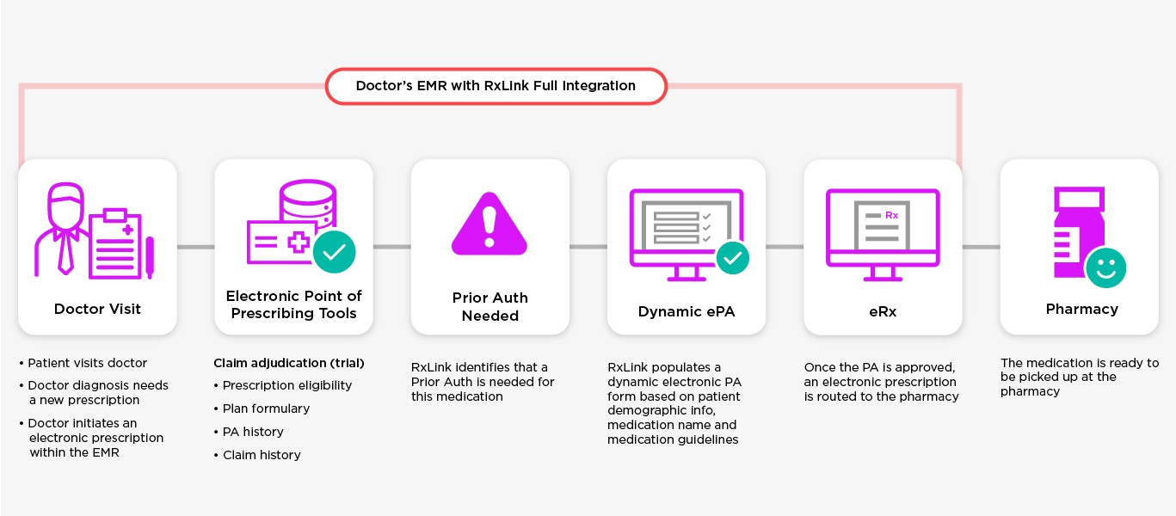
EMR RxLink
Dr. Marshall

Slide 25
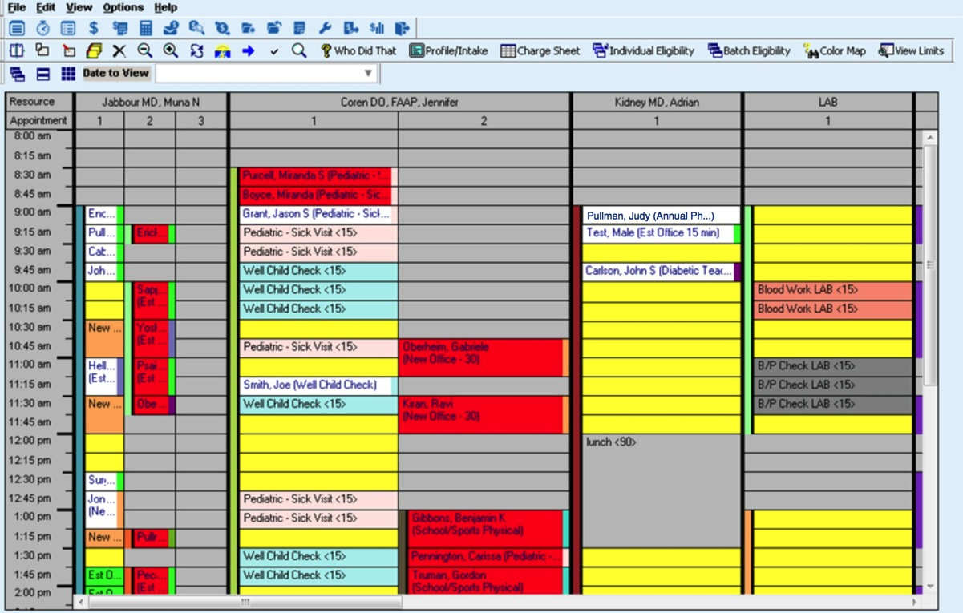
EMR RxLink
Dr. Marshall
Patient Check-In (9:05 am)
Patient Chart
Add Medication
ePA Form
PA Decision
eRx Submitted (9:20 am)
Patient Check-in
During check-in, Judy’s prescription coverage eligibility is confirmed and her formulary data is retrieved.

Slide 26

EMR RxLink
Dr. Marshall
Patient Check-In (9:05 am)
Patient Chart
Add Medication
ePA Form
PA Decision
eRx Submitted (9:20 am)
Patient Chart
The doctor can add a medication directly from Judy’s electronic health record.

Slide 27
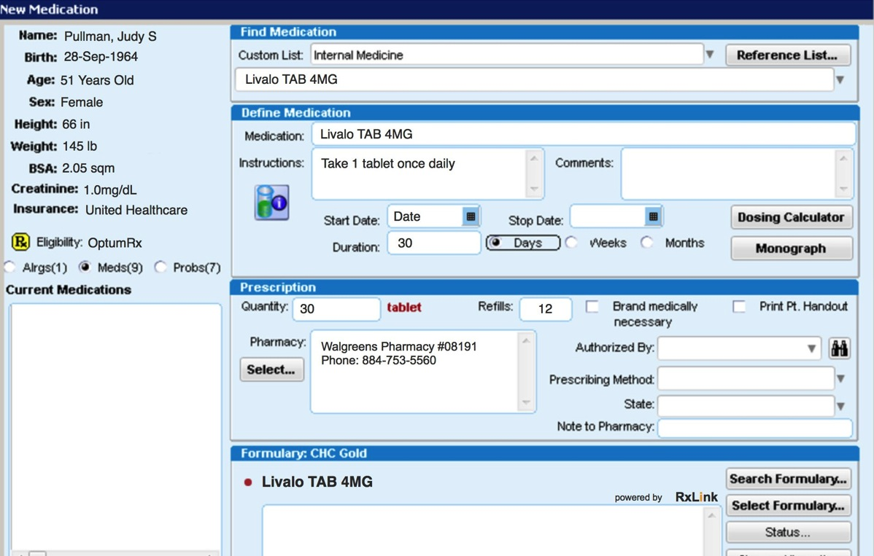
EMR RxLink
Dr. Marshall
Patient Check-In (9:05 am)
Patient Chart
Add Medication
ePA Form
PA Decision
eRx Submitted (9:20 am)
Add Medication
As the doctor adds prescription details into the EMR RxLink integrates with the patient’s health record, plan, eligibility and formulary data to allow the Trial Claim process to instantly validate if a PA is needed.
If the trial claim result is that a prior authorization is needed, an in-line alert is presented. Otherwise, the eRX is routed to the pharmacy.
The doctor is also shown alternative drugs that are therapeutic equivalents to Livalo that do not require a prior authorization and may have a lower cost as well.

Slide 28
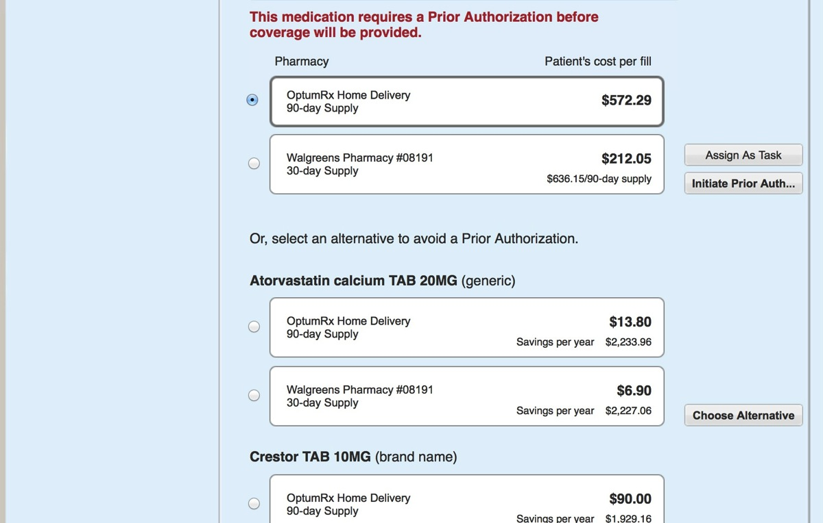
EMR RxLink
Dr. Marshall
Patient Check-In (9:05 am)
Patient Chart
Add Medication
ePA Form
PA Decision
eRx Submitted (9:20 am)
Add Medication
As the doctor adds prescription details into the EMR RxLink integrates with the patient’s health record, plan, eligibility and formulary data to allow the Trial Claim process to instantly validate if a PA is needed.
If the trial claim result is that a prior authorization is needed, an in-line alert is presented. Otherwise, the eRX is routed to the pharmacy.
The doctor is also shown alternative drugs that are therapeutic equivalents to Livalo that do not require a prior authorization and may have a lower cost as well.

Slide 29
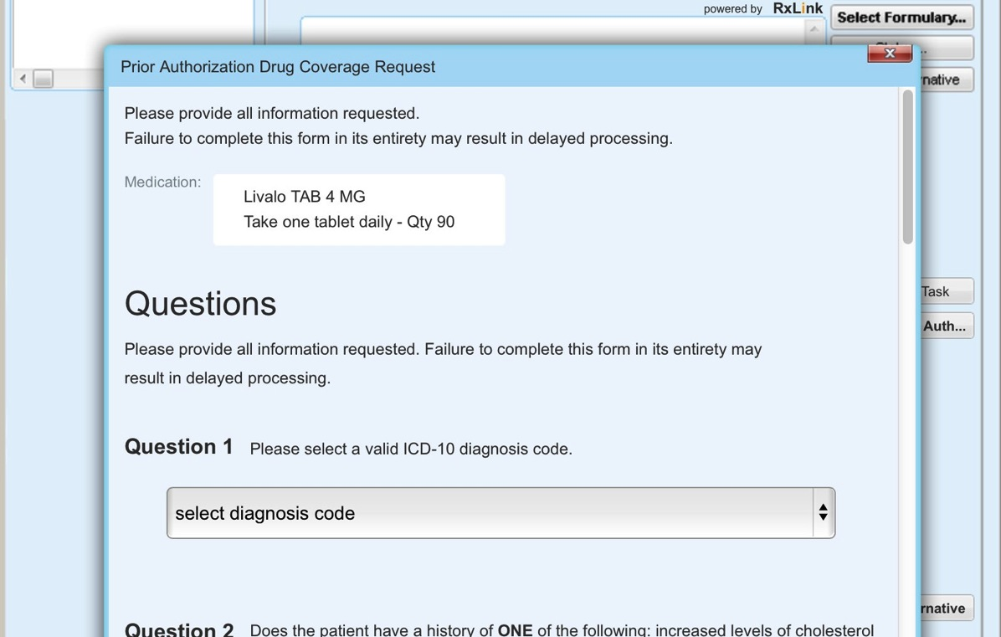
EMR RxLink
Dr. Marshall
Patient Check-In (9:05 am)
Patient Chart
Add Medication
ePA Form
PA Decision
eRx Submitted (9:20 am)
Patient/Drug Specific ePA Request Form
When a PA request is initiated, the prescription is placed in a pending queue until the PA approval decision is made.
If a PA is needed, a patient- specific ePA form is presented, thus allowing the doctor to enter the required info immediately. If extra information is required, the secure messaging feature within RxLink can be used to attach the lab results to the PA form.
As much as possible, the patient information is gathered from the EMR and pre-populated into RxLink.

Slide 30
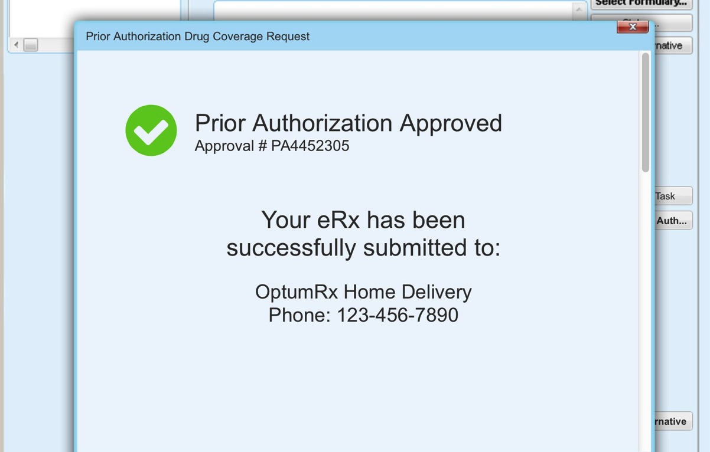
EMR RxLink
Dr. Marshall
Patient Check-In (9:05 am)
Patient Chart
Add Medication
ePA Form
PA Decision
eRx Submitted (9:20 am)
Prior Auth Decision
If appropriate, an immediate ePA approval can be given and the eRx is released from the
pending queue and routed to the pharmacy.
If the PA request cannot be approved immediately it will go into a review process. The doctor and patient will be notified once the decision is made.

Slide 31
EMR RxLink
Dr. Marshall
Patient Check-In (9:05 am)
Patient Chart
Add Medication
ePA Form
PA Decision
eRx Submitted (9:20 am)
Prescription Submitted
Once the prior authorization request is approved and eRx is submitted, the EMR is updated to reflect the new prescription.
Judy is able to go directly to the pharmacy after her doctor’s appointment, pick up her prescription for Livalo, and start her treatment plan.
If Judy uses mail order she can leave the doctor’s office knowing her prescription will arrive at her doorstep in a few days.

Slide 32

Appendix

Slide 33
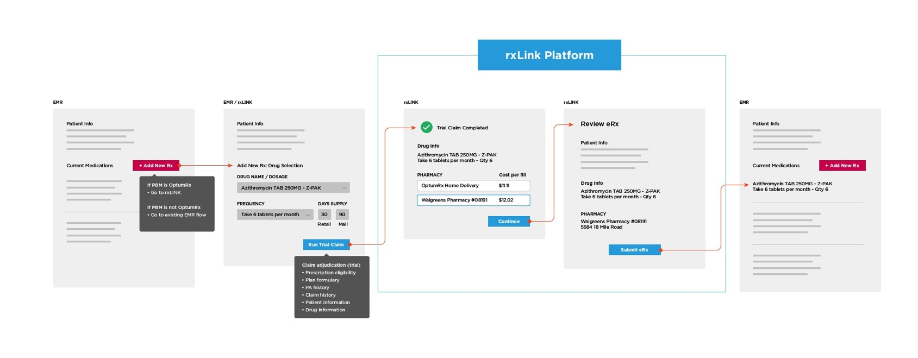
Easy Rx

Slide 34
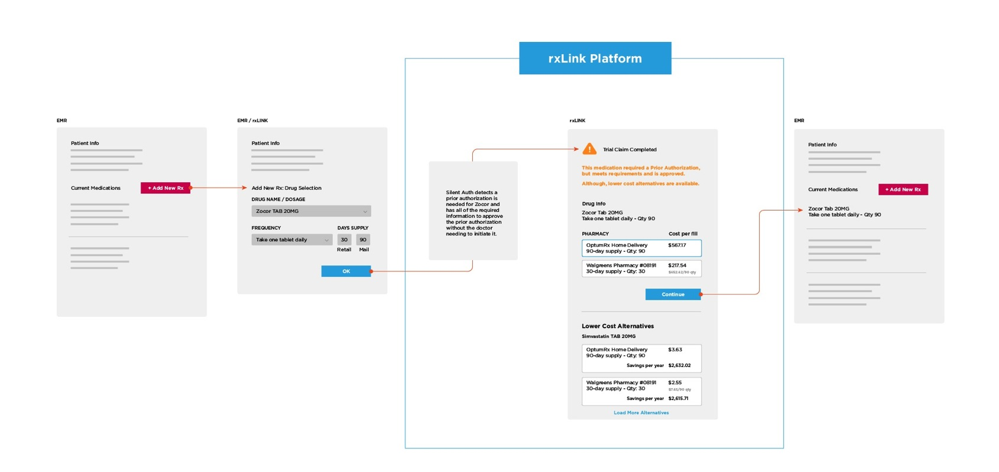
Silent Auth

Slide 35
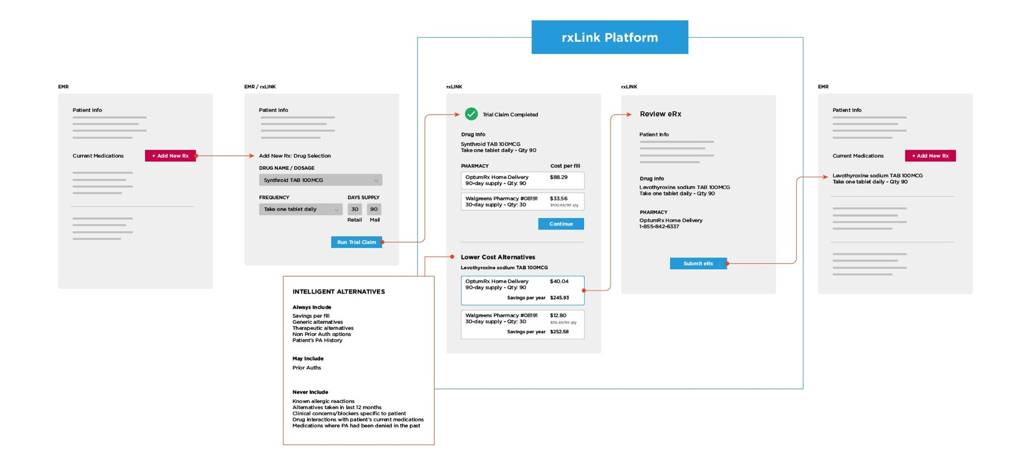
Formulary LCA

Slide 36
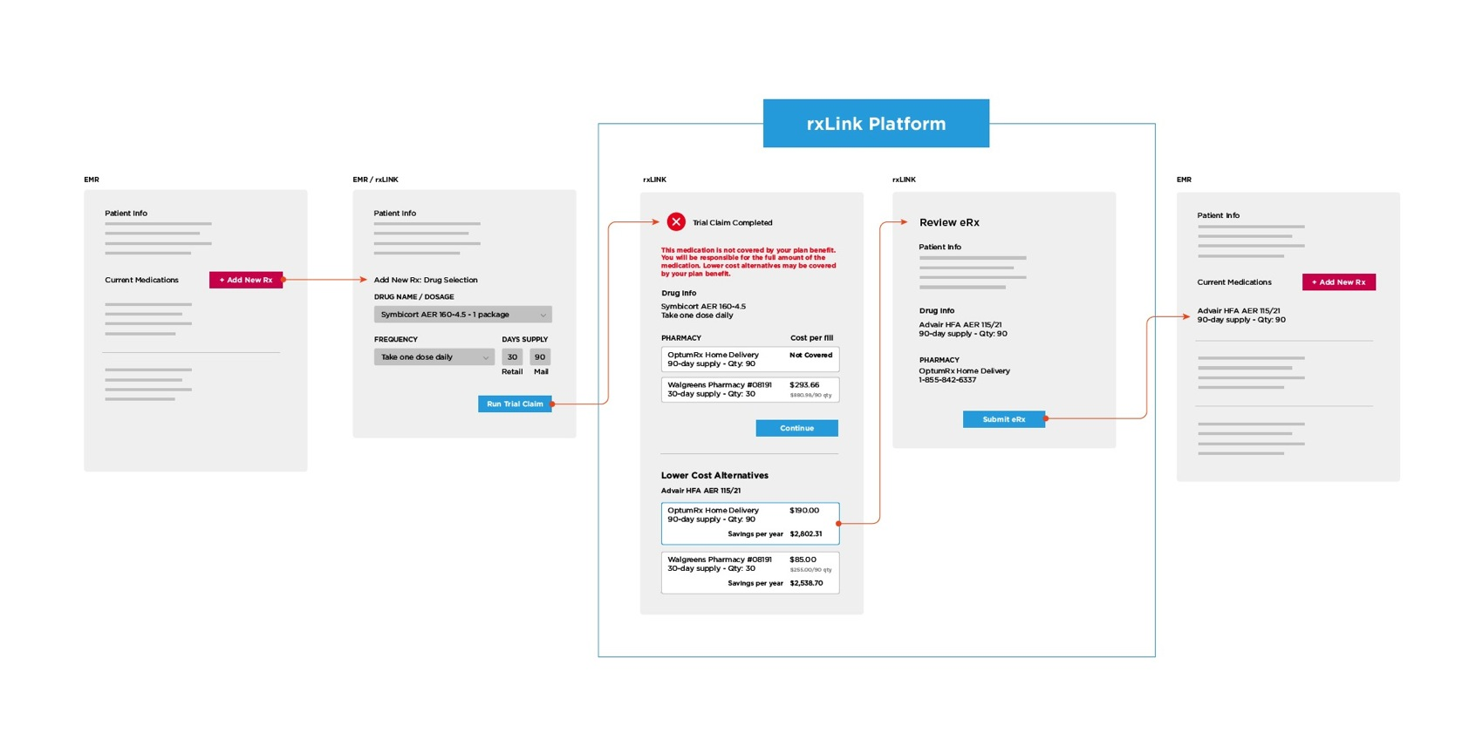
Non-formulary - Formulary

Slide 37
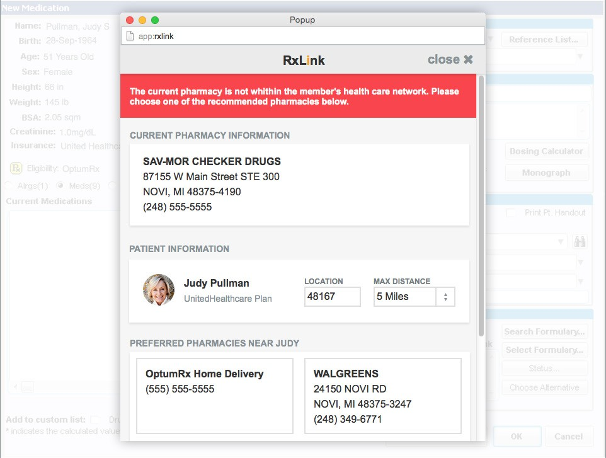
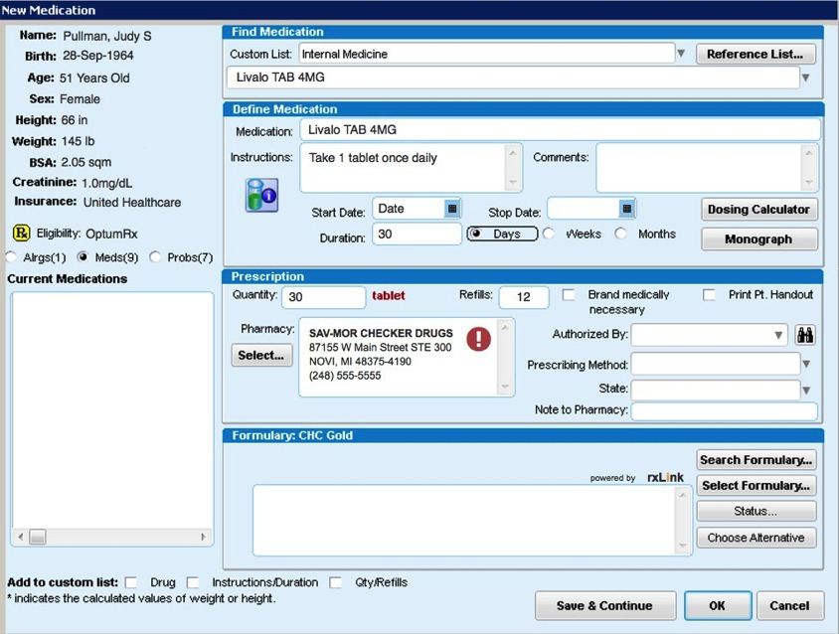
Non-Preferred Pharmacy

Slide 38
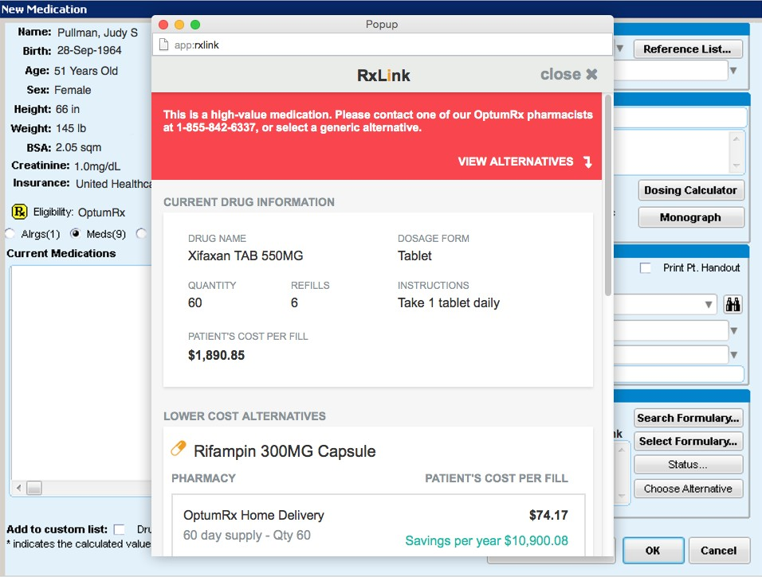
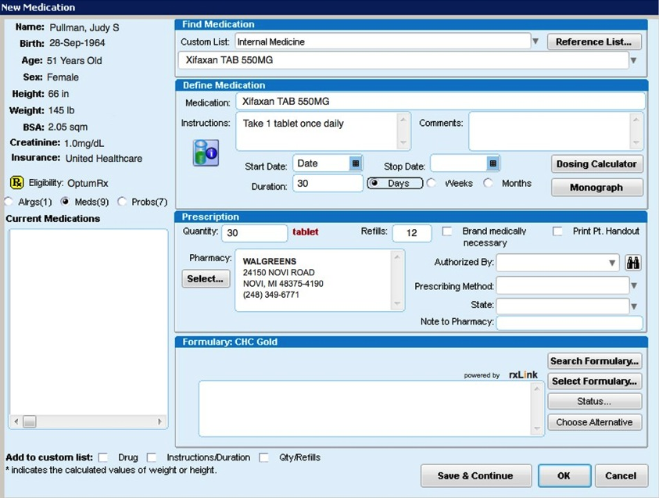
High Value Drug

Slide 39
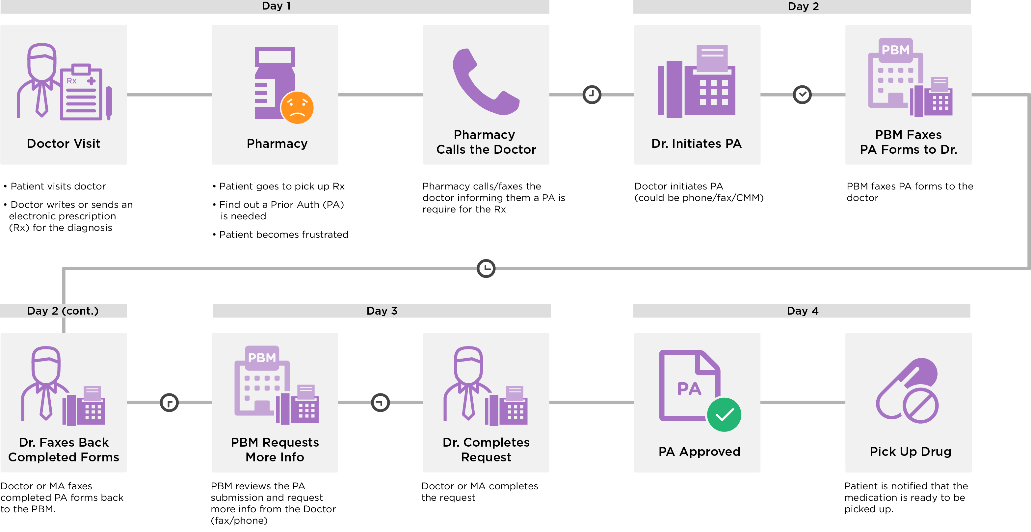
Current State

